Slide 1
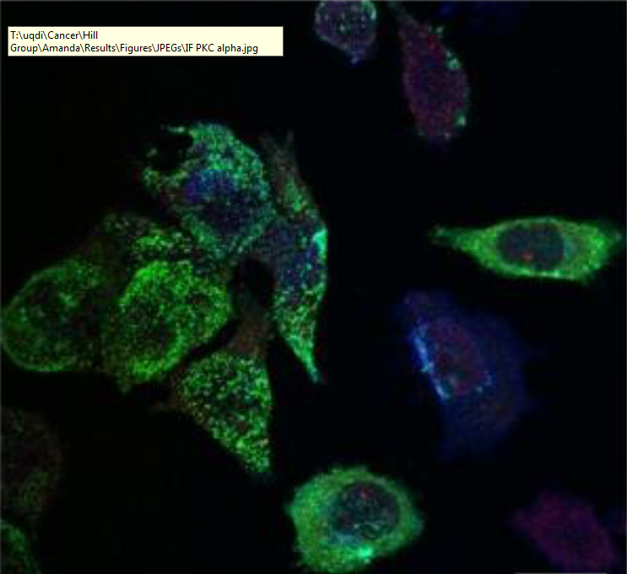
Investigating the mechanism of selective microRNA export via extracellular vesicles
Harley Robinson
Supervisor: A/Prof Michelle Hill
Co-supervisor: Dr Alex Cristino
Notes:
10

Slide 2
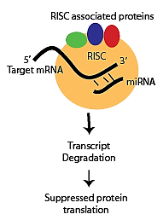
microRNAs
Important regulatory function
Binding to target mRNA decreases protein function by RISC inhibition and degradation (Gregory et al. 2005)
Export of microRNAs (miRs, miRNAs) regulates pathways in the recipient cells (Hannafon & Ding 2013)
Notes:
55. What, how, affect on entire pathways, need for regulation. Recently, an exciting finding…

Slide 3
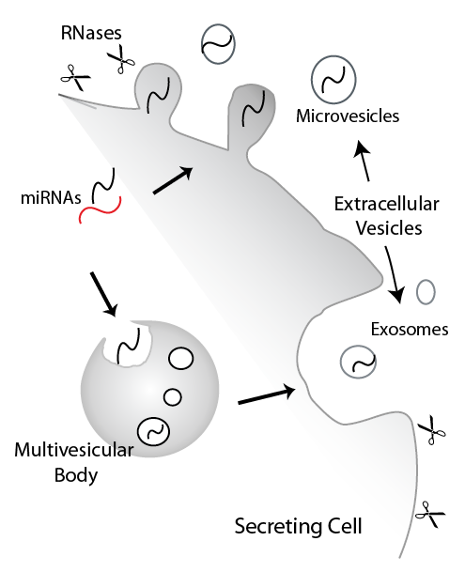
Extracellular Vesicles
Comprised of microvesicles and exosomes.
Increased stability of contents compared to unbound secretion into extracellular serum (Mulcahy et al 2014)
Important for intercellular communication.
Notes:
1.20. Comprised of.., Extracllular space rife with RNase activity.. This allows for the mIRNAs to ove between cells. Hereby detailing a novel echanism for communication.

Slide 4
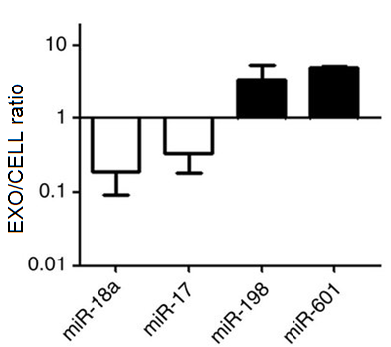
Current miRNA Cargo Sorting Mechanisms.
Previously considered non-selective
miRNAs exported can change disproportionally to the cellular content (Collino et al. 2010; Inder et al. 2014; Villarroya-Beltri et al 2013)
Mechanism of export still unknown
(Villarroya-Beltri et al 2013)
Notes:
2.15. Very little is known about miRNA export. Previously non-selective (define). Link to slide as selective. hnRNP subset of 30miRs. No known regulation, no known mechanisms for the other miRs

Slide 5
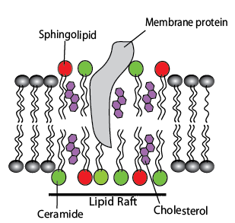
Lipid Rafts Effecting Cargo Sorting
Sorting may be impacted by lipid raft composition.
EVs contain cholesterol, sphingolipid and ceramide enriched microdomains. (Cocucci et al. 2015)
Depletion of cholesterol, ceramide and sphingolipid modified EV protein content. (Leyt et al 2007; Trajkovic et al 2008; Phuyal et al 2014)
Notes:
2.55. Lipid raft composition may be key.. Lipid rafts are.. Rafts enriched in.. Investigating the role of these lipid rafts through depletion..

Slide 6
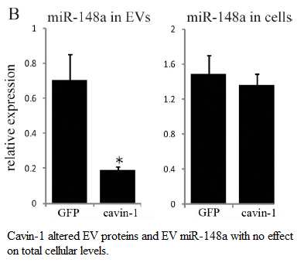

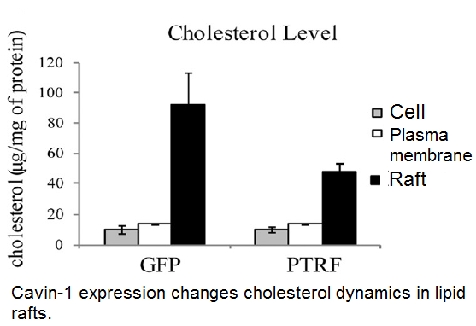
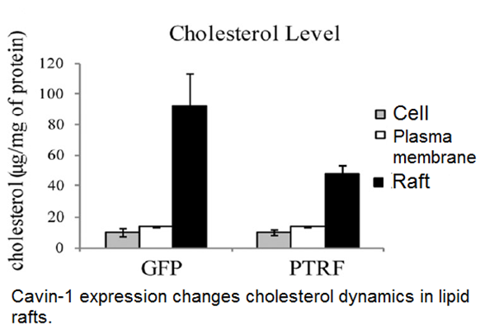
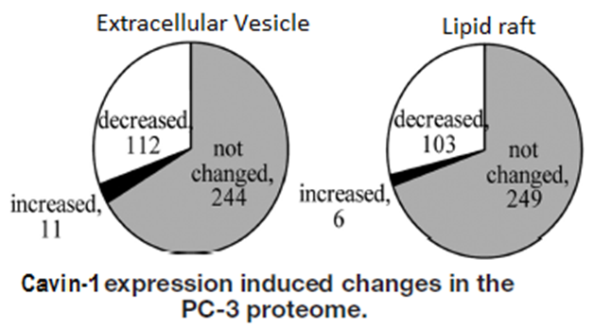
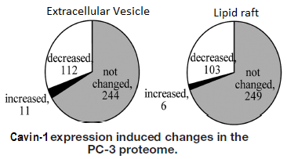
Experimental Model: Cavin-1 in PC3 Cells.
PC3 cells: Aggressive prostate cancer cell line
Introduction of Cavin-1 results in reduced oncogenic behaviour, modulated cholesterol re-distribution, protein content and EV miRNA content.
(Inder et al 2012; Inder et al 2014)
Notes:
3.55

Slide 7
Hypotheses and Aims:
Hypothesis:
Extracellular vesicle miRNA content is mediated by RNA-binding proteins modulated by lipid raft composition.
Aims:
Identify the selectively exported miRNAs
Identify RNA-binding proteins correlated to the miRNA export
Verify candidate miRNA escort proteins ability to bind to miRNAs and transport to extracellular vesicles.
Notes:
4.25

Slide 8

Aim 1: Analysis of miRNA Export
Method 1: Bioinformatics
miRNA-seq data compiled: EVs and cell from PC3-GFP and PC3-GFP::Cavin1 cells.
DEseq2 and egdeR find differences in miRNA levels between cell lines
Compare between cell and EV to find selectively exported miRNAs.
Method 2: RT-qPCR
Notes:
5.30

Slide 9
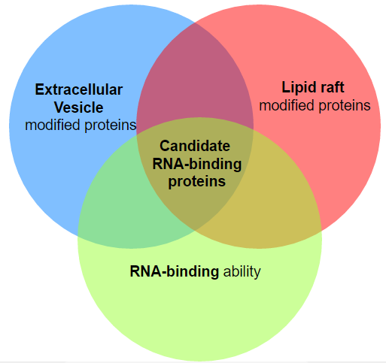
Aim 2: Identify Candidate miR Binding Proteins.
Method 1: Computational analysis.
Proteomics collected for the lipid raft and EVs for PC3 GFP and PC3 cavin-1 cells.
Identify proteins modified in EV and lipid raft fraction between cell lines
Gene Ontology analysis determines RNA-binding ability.
Notes:
6.05. GO:0003723

Slide 10

Aim 2: Identify Candidate miR Binding Proteins.
Method 2: Motif discovery.
Compare known RNA-binding motif of candidate protein to miRNA.
Known binding miRNAs:
miR-198; GGUCCAGAGGGGAGAUAGGUUC
miR-887; CUUGGGAGCCCUGUUAGACUC
Non-binding miRNAs:
miR-20b; CAAAGUGCUCAUAGUGCAGGUAG
Expected Results: Selectively exported miRNA should contain the candidate’s RNA-binding motif, where non-selective will not.
Notes:
6.50

Slide 11
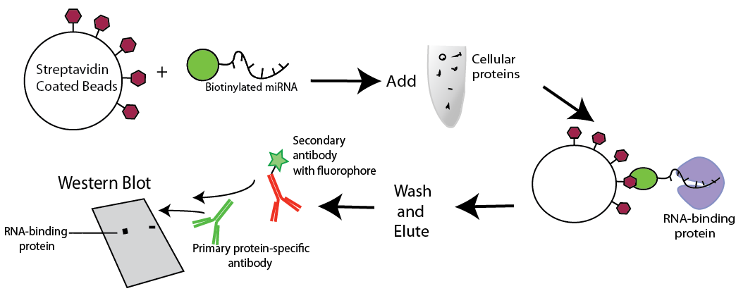
Aim 3: Verification of miR Candidate.
Method 1: Pull down assay
Notes:
7.25

Slide 12
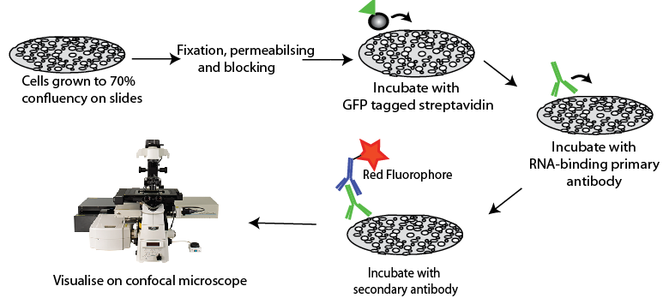
Aim 3: Verification of miR Candidate.
Method 2: Co-localisation by Immunofluorescence Confocal Microscopy
Cells transfected with biotinylated miRNAs
Co-localized miRNA + protein will be observed as yellow.

Slide 13
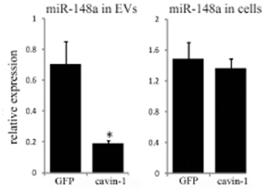
Significance
Increases proliferation of
Osteoblast.
Novel miRNA function
Irregularities in sorting can cause dysfunction in recipient cells.
MiRNAs exported within EVs have been linked to cancer metastasis

Slide 14



Acknowledgements
Supervisor: A/Prof Michelle Hill
Co-supervisor: Dr Alex Cristino
Hill Lab

Slide 15
DESeq2 EdgeR method
Differential expression method: Input RNA-seq raw counts -> Filter out low-no reads and normalize -> Establish design -> Differential expression analysis (DESeq(list) function) -> Returns log2fold change , p-values, and Adjusted p values.
Data quality assessment: MDS plot, dendrogram, PCA plot
Comparisons:
- PC3 EV vs PC3 Cavin-1 EV = FC of miRNAs differentially exported due to lipid raft change.
PC3 cell miRs vs PC3 Cavin-1 miRs = FC of miRNAs differentially expressed due to cavin-1 introduction
Selectively exported miRs: Compare FC(cell) / FC (exo). If ~ 1, then non-selective. Else: Selective
Notes:
Why filter? Increases the speed of the transformation and testing.

Slide 16
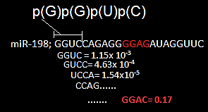
Motif Scan
G | 0.495 | 0.97 | 0.29 | 0.74
C | 0.099 | 0.01 | 0.39 | 0.24
A | 0.010 | 0.01 | 0.49 | 0.01
U | 0.395 | 0.01 | 0.01 | 0.01

